Slide 1
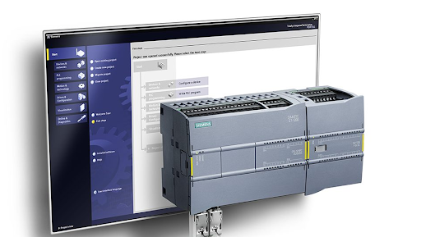
Lesson 1:
PROGRAMMABLE CONTROLS
1.1 OVERVIEW OF PROGRAMMABLE CONTROLS

Slide 2

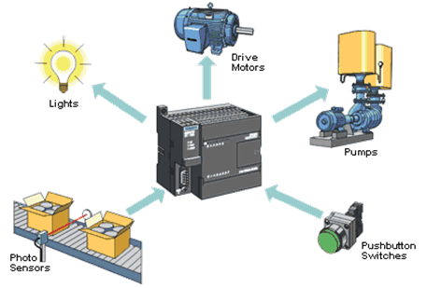
LESSON OBJECTIVES
After completing this lesson, learners will be able to:
Compare the pros and cons of programmable control with other forms of control.
Speech on the concept of programmable control.
Present the applications of PLC in practice.
INS3150 - PROGRAMMING PLC

Slide 3
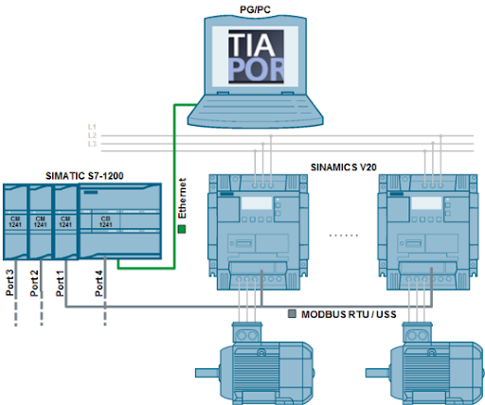
1.1 OVERVIEW OF PROGRAMMABLE CONTROLS
Control overview.
Hardwired control and programmable control.
Compare PLC with other controls.
Applications of PLC in real life.
INS3150 - PROGRAMMING PLC
3

Slide 4
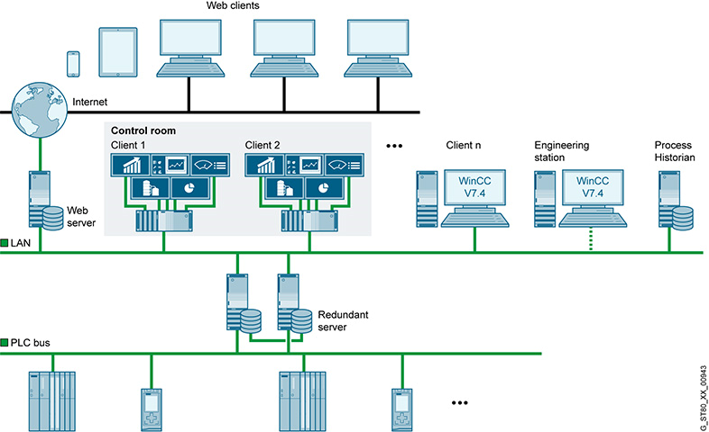
1.1 OVERVIEW OF PROGRAMMABLE CONTROLS
Nowadays, the requirements for automation in industry are increasing, requiring many changes in control techniques in terms of equipment as well as control methods.
In the field of control, two control methods are distinguished:
+ Hard-connected control method.
+ Programmable control method.
INS3150 - PROGRAMMING PLC

Slide 5
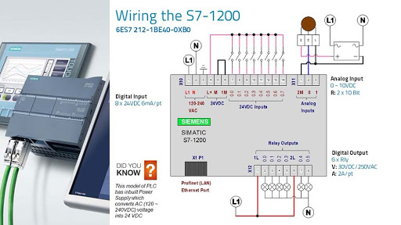
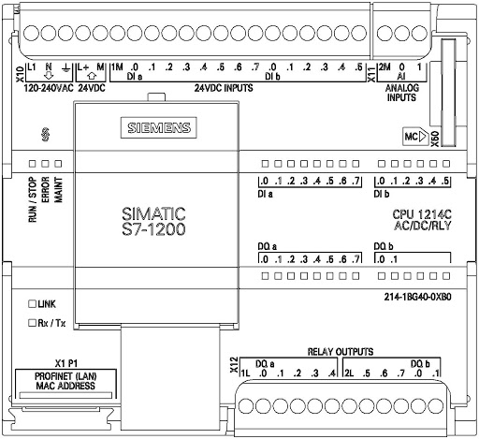
MECHANICAL CONTROLS
1.1 OVERVIEW OF PROGRAMMABLE CONTROLS
+ Contact-based hard-connected controls:
Using electromagnetic instruments such as relays, contactors, sensors, etc.
These instruments are connected together according to specific circuits.
+ Non-contact hardfacing control:
Using logic gates, digital ICs, sensors, etc.
Power components such as SCR, TRIAC.
INS3150 - PROGRAMMING PLC

Slide 6
1.1 OVERVIEW OF PROGRAMMABLE CONTROLS
HARDWIRING CONTROL STEPS
Define technology requirements
Control scheme design
Selecting Circuit Elements
Circuitry, bonding of elements
Test Run - Circuit Test
INS3150 - PROGRAMMING PLC

Slide 7
1.1 OVERVIEW OF PROGRAMMABLE CONTROLS
EXAMPLE 1
•
•
Off
Off
•
•
•
•
ON
K₁
ON
K₃
K₁
K₃
•
•
R_{th1}
R_{th2}
R_{th1}
R_{th2}
•
•
•
•
K₁
K₂
K₃
K₂
The two motor run sequentially
Two motors sequential stops
INS3150 - PROGRAMMING PLC

Slide 8
1.1 OVERVIEW OF PROGRAMMABLE CONTROLS
•
•
•
EXAMPLE 2
Off
•
ON
K₁
R_{T}
K₁
•
R_{th1}
R_{th2}
•
•
•
K₁
R_{T}
K₂
Two motors run sequentially, stop sequentially
INS3150 - PROGRAMMING PLC

Slide 9

PROGRAMMABLE CONTROLS
1.1 OVERVIEW OF PROGRAMMABLE CONTROLS
+From the two examples, when the control requirements change, the diagram becomes complex, requiring more power tools (example 2).
+ For the programmable method, to change the program, just change the contents of the internal memory, the external wiring is not affected.
INS3150 - PROGRAMMING PLC

Slide 10
1.1 OVERVIEW OF PROGRAMMABLE CONTROLS
1.1 TỔNG QUAN VỀ ĐIỀU KHIỂN LẬP TRÌNH
PROGRAMMABLE CONTROL STEPS
Define technology requirements
Algorithm Design
Program Drafting
Load programs into memory
Test Run - Circuit Test
PLC CƠ BẢN
INS3150 - PROGRAMMING PLC

Slide 11
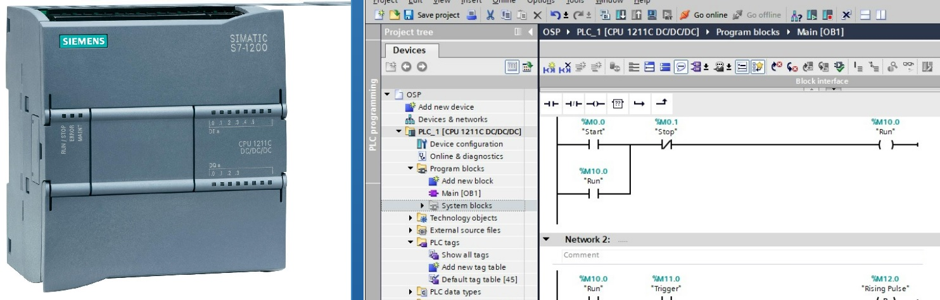
1.1 OVERVIEW OF PROGRAMMABLE CONTROLS
EXAMPLE 3
We just need to write a program to load into the memory of the PLC
3
2
1
Software Programming
Connect the PLC to a computer with software (with driver)
Transfer the program to the PLC
INS3150 - PROGRAMMING PLC
Notes:
Ta cần thay đổi chương trình bên trong PLC

Slide 12
1.1 OVERVIEW OF PROGRAMMABLE CONTROLS
ADVANTAGES OF PLC
Small size.
Design changes are easier and faster when required.
There is a fault diagnosis and override function.
PLCs allow for maximum automation at minimal cost.
Installation, programming and operation are simple.
The CPUs can be used in a network, distributed system, or single use.
Capable of large-scale integration.
App for simple and complex controls.
Less training time is required.
Strong communication (PPI, Profibus-DP, AS-i)...
INS3150 - PROGRAMMING PLC

Slide 13
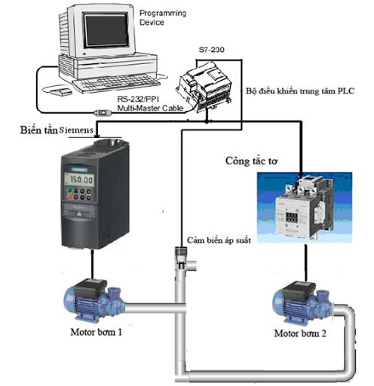
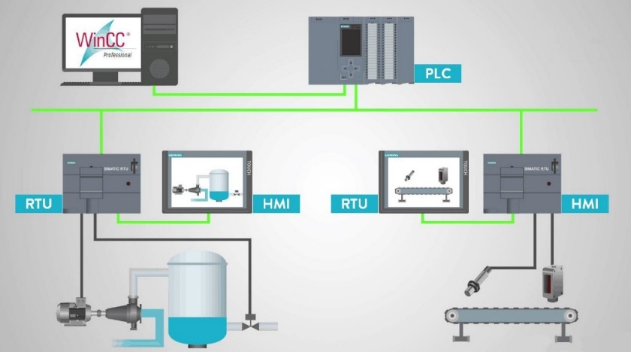
1.1 OVERVIEW OF PROGRAMMABLE CONTROLS
ADVANTAGES OF PLC
In Civil:
Small PLCs such as LOGO are used to control lighting equipment, ventilation systems, pumps, etc.
In industry:
+ Elevator.
+ Automated production lines.
+ Computerization of work in production control.
+ Industrial robots...
INS3150 - PROGRAMMING PLC
Notes:
Các PLC cỡ nhỏ như LOGO dùng để điều khiển các thiết bị chiếu sáng, hệ thống thông gió, bơm…

Slide 14
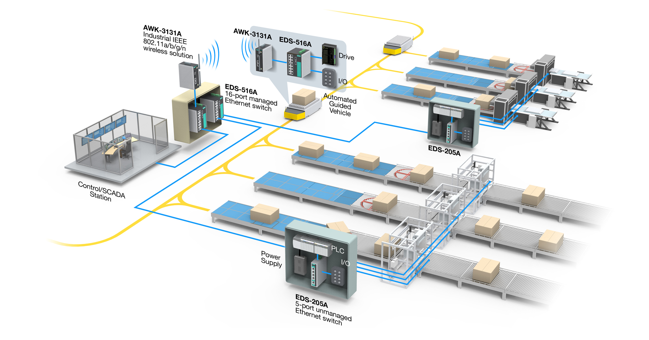
1.1 OVERVIEW OF PROGRAMMABLE CONTROLS
APPLICATION OF PLC
https://www.youtube.com/watch?v=kosiOQzvZvY
INS3150 - PROGRAMMING PLC

Slide 15
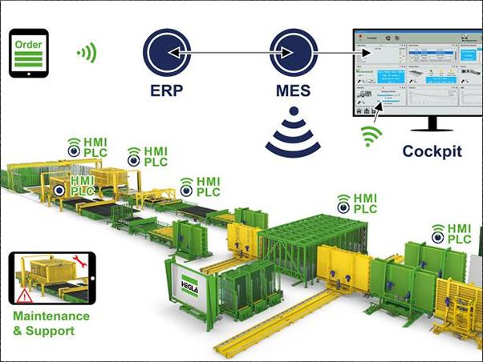
1.1 OVERVIEW OF PROGRAMMABLE CONTROLS
APPLICATION OF PLC
https://youtu.be/u2SF9QOQs6s
INS3150 - PROGRAMMING PLC

Slide 16
Lesson 1:
PROGRAMMABLE CONTROLS
1.2 STRUCTURE PLC
INS3150 - PROGRAMMING PLC

Slide 17

LESSON OBJECTIVES
After completing this lesson, learners will be able to:
State the structure of a PLC according to the learned content.
Presentation of the S7- 1200 programmable control devices.
Presentation of the S7- 1200 memory structure.
Handle the program exactly according to the content learned.
INS3150 - PROGRAMMING PLC

Slide 18
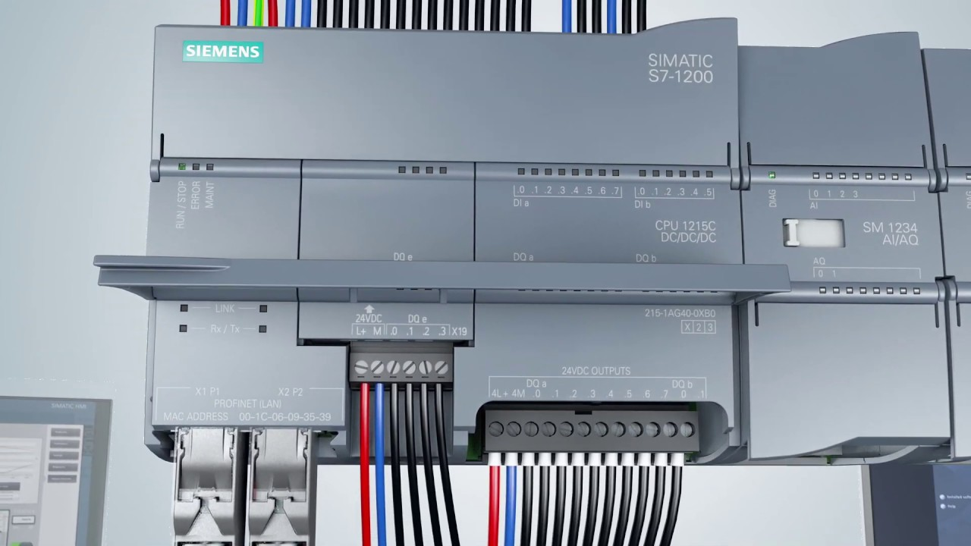
LESSON CONTENT
Structure of a PLC.
S7-1200 Programmable Control Unit.
S7-1200 Memory Structure.
Expand the in/out port.
Implement the program.
Structure of the S7-1200 program.
INS3150 - PROGRAMMING PLC

Slide 19
LESSON CONTENT
STRUCTURE A PLC
Program
•
•
•
•
•
•
Block
source
Output
module
Memory
program
CPU
Processor
Input module
INS3150 - PROGRAMMING PLC

Slide 20
1.2 STRUCTURE A PLC
BLOCK FUNCTIONS
Power block: the power in the PLCs is usually 24VDC, there are also PLC sets that use 220VAC power. PLCs that do not have a power module are powered externally.
CPU module: (CPU: central processing unit) includes: microprocessor and memory.
I/O module.
+ Input module is connected to switches, push buttons, sensors, etc. to control from an external program.
+ The output module is connected to the loads at the output such as the coil of the relay, contactor, signal light, optical coupler, etc.
INS3150 - PROGRAMMING PLC

Slide 21
1.2 STRUCTURE A PLC
BLOCK FUNCTIONS
Signal transmission bus system: the signal transmission bus system consists of multiple parallel signal lines:
Address bus: select addresses on different blocks.
Data bus: carries data from one block to another.
Control bus: transmits and transmits tensor signals and controls to synchronize operations in the PLC.
The control program is loaded into memory either by a handheld programming console or by a computer. There are now a number of PLCs that are designed with keystrokes so that they can be programmed directly without the need for a handheld programmer or computer.
INS3150 - PROGRAMMING PLC

Slide 22
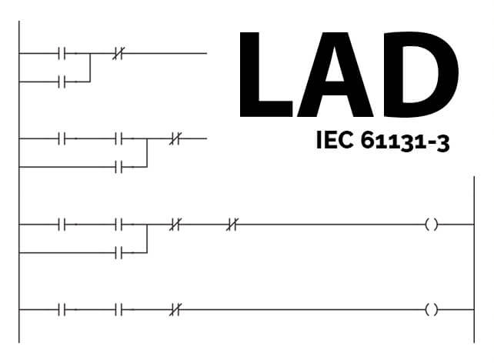
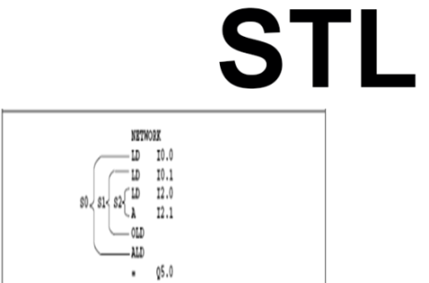
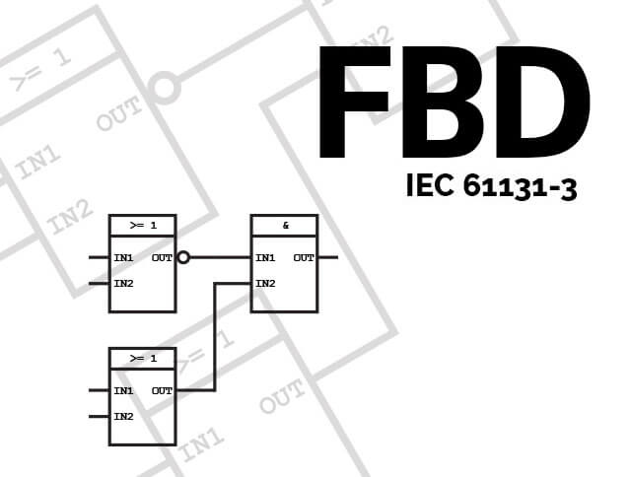
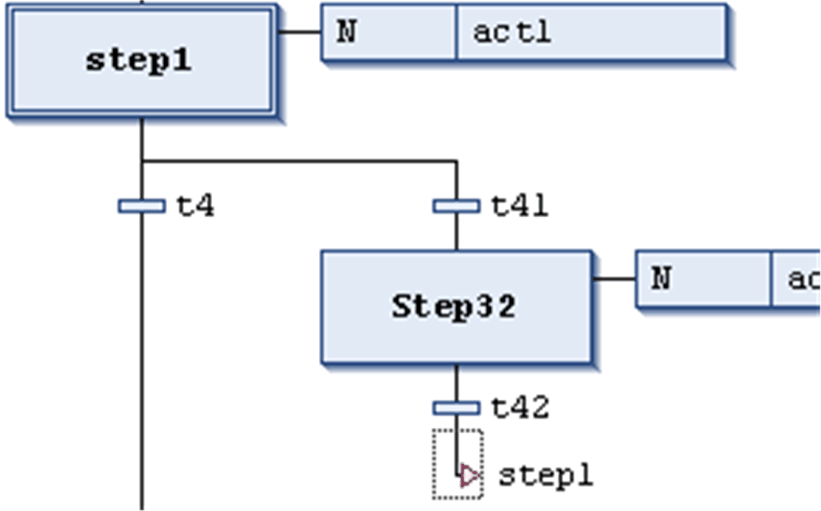
1.2 STRUCTURE A PLC
PROGRAMMING LANGUAGES ON PLC
To represent the control program on a PLC, three methods are usually used:
+ Ladder Diagram (LAD).
+ SFC (Sequential function chart) or FBD (Function Block Diagram).
+ List the STL (Statement List) command list.
SFC
INS3150 - PROGRAMMING PLC

Slide 23
1.2 STRUCTURE A PLC
LAD PERFORMANCE METHOD
This method has a similar representation to a relay contact diagram in industrial power.
•
OFF
X0
X1
Y0
•
ON
K1
•
K1
X2
•
Demonstration according to mechanical contact diagram
LAD Programming Representation
INS3150 - PROGRAMMING PLC

Slide 24
1.2 STRUCTURE A PLC
SFC OR FBD PERFORMANCE
This method represents the program as a diagram using logical ports (usually used in European notation).
X0
-1
&
Y0
X1
>=1
X2
SFC Representation Method
FBD Performance Method
INS3150 - PROGRAMMING PLC

Slide 25
1.2 STRUCTURE A PLC
STL PERFORMANCE METHOD
The STL method uses evocative acronyms, similar to computer assembler language.
Example:
LDI X0
LD X1
OR X2
ANB
OUT Y0
X0
X1
Y0
X2
INS3150 - PROGRAMMING PLC

Slide 26

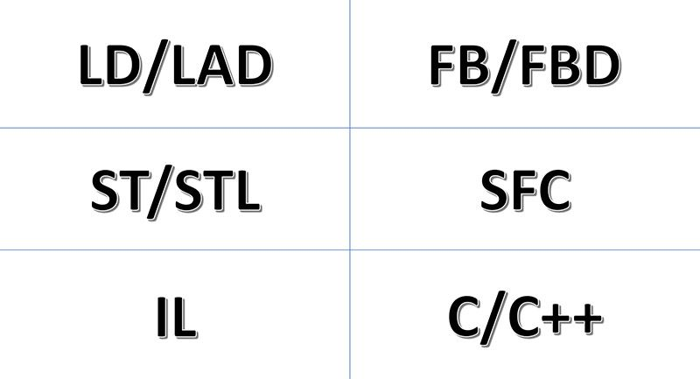
1.2 STRUCTURE A PLC
PLC PROGRAMMING LANGUAGE
Through the examples, we see that the three methods of representation belong to the three different fields.
The Industrial Power industry often uses the LAD method.
The Electronics industry often uses the SFC or FBD method.
Informatics often uses the STL method.
INS3150 - PROGRAMMING PLC

Slide 27
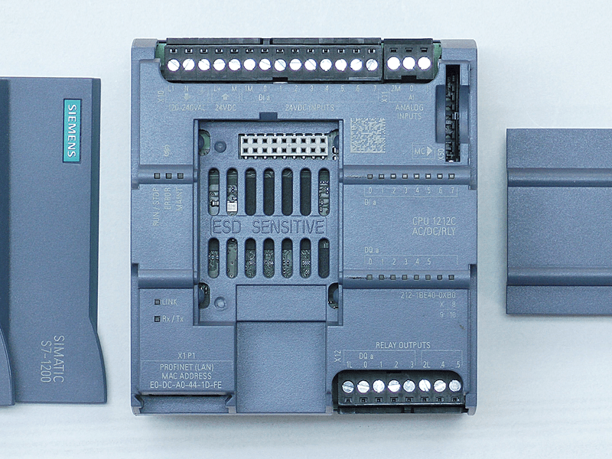
1.2 STRUCTURE A PLC
S7-1200 PROGRAMMABLE CONTROL UNIT
Power supply
Communication of Input Modules
Memory Card
Working mode indicator light
Input signal indicator light
Output wiring ports
Communication Portal
Output signal indicator light
INS3150 - PROGRAMMING PLC

Slide 28
1.2 STRUCTURE A PLC
S7-1200 PROGRAMMABLE CONTROL UNIT
COMPONENTS
PLC S7-1200 INCLUDES:
- 03 Compact controllers with classification in different versions like wide-range AC or DC control;
- 02 Analog circuits and expansion numbers control the module directly on the CPU, reducing the product cost;
- 13 different digital and analog signal modules;
- 02 RS232/RS485 communication modules for communication through PTP connection;
- Adding 04 Ethernet ports;
- Stable PS 1207 power module, 115/230 VAC current and 24 VDC voltage
INS3150 - PROGRAMMING PLC

Slide 29
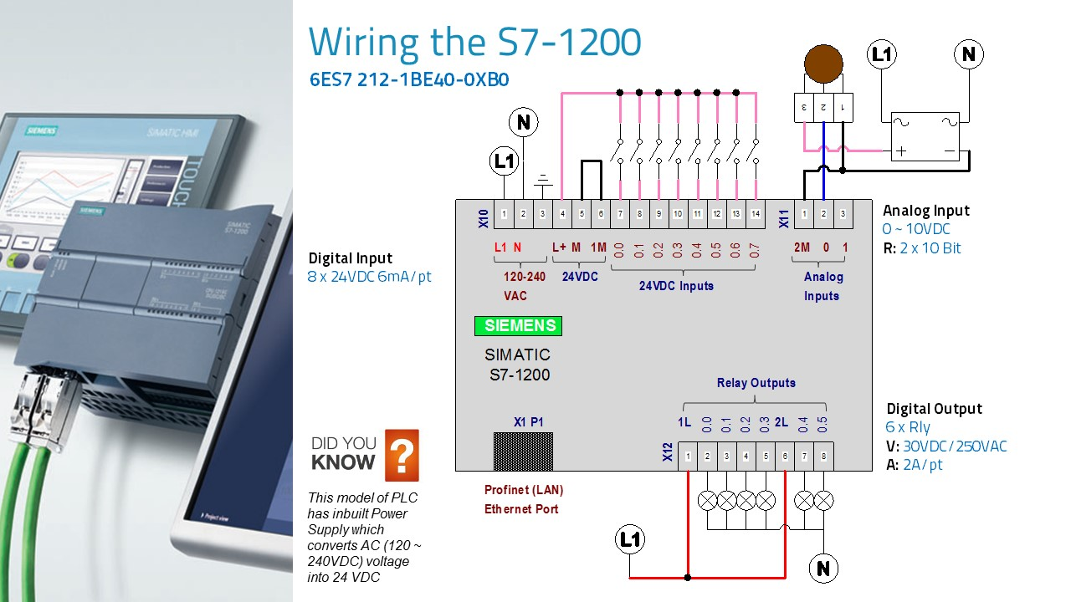
1.2 STRUCTURE A PLC
S7-1200 PROGRAMMABLE CONTROL UNIT
COMPONENTS
PLC S7-1200 INCLUDES:
INS3150 - PROGRAMMING PLC

Slide 30
1.2 STRUCTURE A PLC
DESCRIPTION OF THE INDICATOR LIGHTS ON THE S7-1200
SF (red light): An SF red light indicates a system failure.
RUN (green light): The RUN green light indicates that the PLC is in working mode and performs the feeding program into the machine.
STOP(yellow light): The STOP yellow light indicates the PLC is in stop mode.
Ix.x (green light): The green light at the entrance gate indicates the instantaneous status of port Ix.x (x.x = 0.0 to 1.5). This light signals the status of the signal according to the logical value of the gate.
Qy.y (green light): The green light at the output gate signals the instantaneous status of the Qy.y gate (y.y = 0.0 to 1.1). This light signals the status of the signal according to the logical value of the gate.
INS3150 - PROGRAMMING PLC

Slide 31
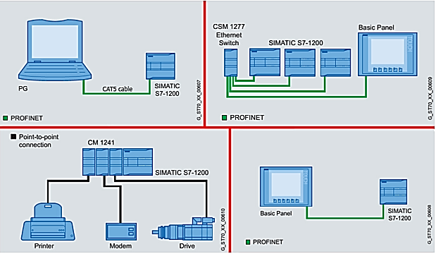
1.2 STRUCTURE A PLC
COMMUNICATION PORTAL S7-1200
Communicate
The S7-1200 supports Profibus connection and PTP (point to point) connection.
PROFINET communicates with:
- Programmable Devices
- HMI Equipment
- Other SIMATIC controllers
Supports connection protocols:
- TCP/IP
- SIO-on-TCP
- Communication with S7
INS3150 - PROGRAMMING PLC

Slide 32
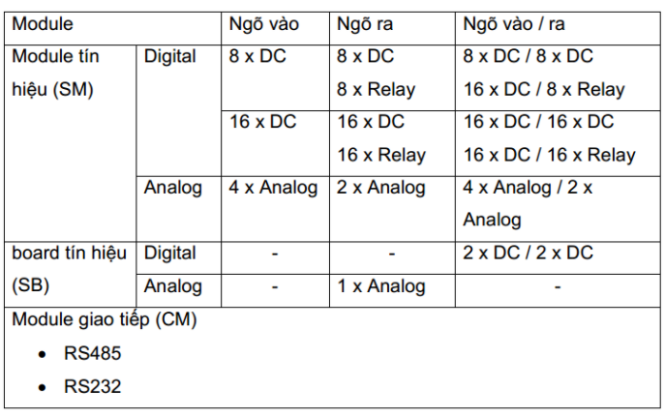
1.2 STRUCTURE A PLC
COMMUNICATION PORTAL S7-1200
Signal Board of PLC S7-1200
Signal board – a type of module that expands in/out signals with a small number of signals, helping to save costs for applications that require small signal number expansion.
Includes boards:
- 1 12-bit analog output port (+- 10VDC, 0-20mA);
- 2 input signal ports;
- 2 signal output ports, 0.5A.
INS3150 - PROGRAMMING PLC

Slide 33
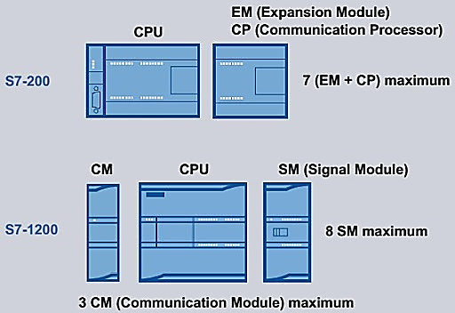
1.2 STRUCTURE A PLC
COMMUNICATION PORTAL S7-1200
The S7-1200 has the following types of expansion modules:
- Communication module (CP).
- Signal board (SB)
- Signal Module (SM)
INS3150 - PROGRAMMING PLC

Slide 34
1.2 STRUCTURE A PLC
S7-1200 MEMORY STRUCTURE
Program
Program
Program
Capacitor
Parameter
Parameter
Parameter
Data
Object
Object
Object
EEPROM
External memory domains
INS3150 - PROGRAMMING PLC

Slide 35
1.2 STRUCTURE A PLC
DIVIDING MEMORIES:
Program Region: This is the memory domain used to store program commands. Read/write area.
Parameter area: It is the domain that stores parameters such as keywords, temporary addresses, etc. Read/write area.
Data region: Stores data such as the results of calculations, constants defined in the program, media buffers, etc. Read/write zone.
Object Area: Timer, counter, high-speed counter, analog I/O ports. Read/write area.
The last two memory areas are important, which are detailed in the following section.
INS3150 - PROGRAMMING PLC

Slide 36
1.2 STRUCTURE A PLC
DATA AREA:
A data region is a dynamic memory region.
Accessed bit-by-bit, byte-byte, single word or double word.
Used as a data storage domain for algorithms, communication functions, tabling, shift functions, record rotating, address pointers.
Data area are divided into small memory domains with different uses. They are denoted as follows:
+ V : Variable memory.
+ I : Input image register.
+ O : Output image register
+ M : Internal memory bits.
+ SM : Special memory bits.
INS3150 - PROGRAMMING PLC

Slide 37
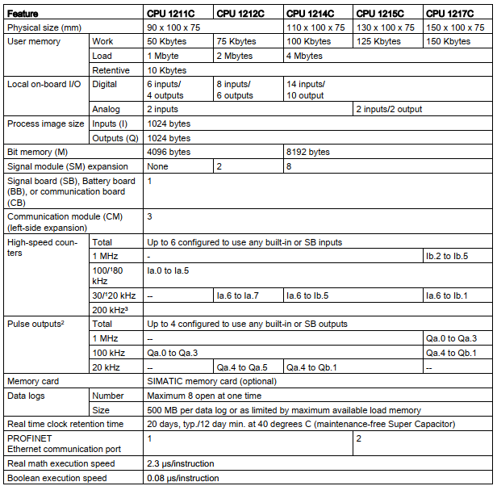
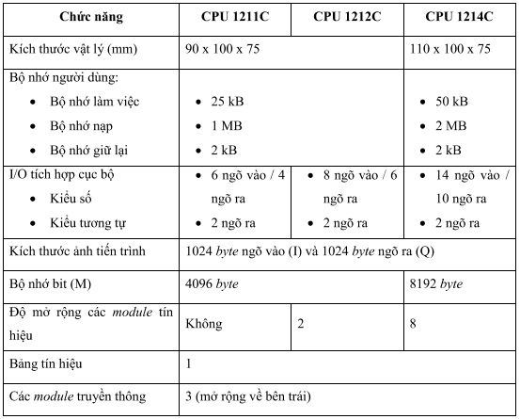
1.2 STRUCTURE A PLC
CPU OBJECT PARTITIONING
CPU S7-1200
INS3150 - PROGRAMMING PLC

Slide 38
1.2 STRUCTURE A PLC
EXPANDING THE CPU IN AND OUT
The I/O port of the PLC can be expanded by adding to it the expansion modules towards the right side of the CPU, forming a chain.
The address of the position of the module is determined by the input/exit type and of the module in the chain hook including the module of the same type.
For example, an output module cannot be assigned the address of an input module, just as an analog module cannot be addressed as a number module, and vice versa.
Digital or similar modules all occupy space in the buffer corresponding to the number of inputs/outputs of the module.
INS3150 - PROGRAMMING PLC

Slide 39
1.2 STRUCTURE A PLC
EXPANDING CPU IN/OUT PORTS
Module 0
4vào/4ra
Module 1
8 vào
Module 2
3vào/ 1ra
Module 3
8 ra
Module 4
3vào/ 1ra
CPU
I0.0
I0.1
I0.2
I0.3
I0.4
I0.5
I0.6
I0.7
I1.0
I1.1
I1.5
I2.0
I2.1
I2.2
I2.3
Q2.0
Q2.1
Q2.2
Q2.3
I3.0
I3.1
I3.2
I3.3
I3.4
I3.5
I3.6
I3.7
AIW0
AIW2
AIW4
AQW0
Q3.0
Q3.1
Q3.2
Q3.3
Q3.4
Q3.5
Q3.6
Q3.7
AIW8
AIW10
AIW12
AQW4
Q0.0
Q0.1
Q0.2
Q0.3
Q0.4
Q0.5
Q0.6
Q0.7
Q1.0
Q1.1
…
INS3150 - PROGRAMMING PLC

Slide 40
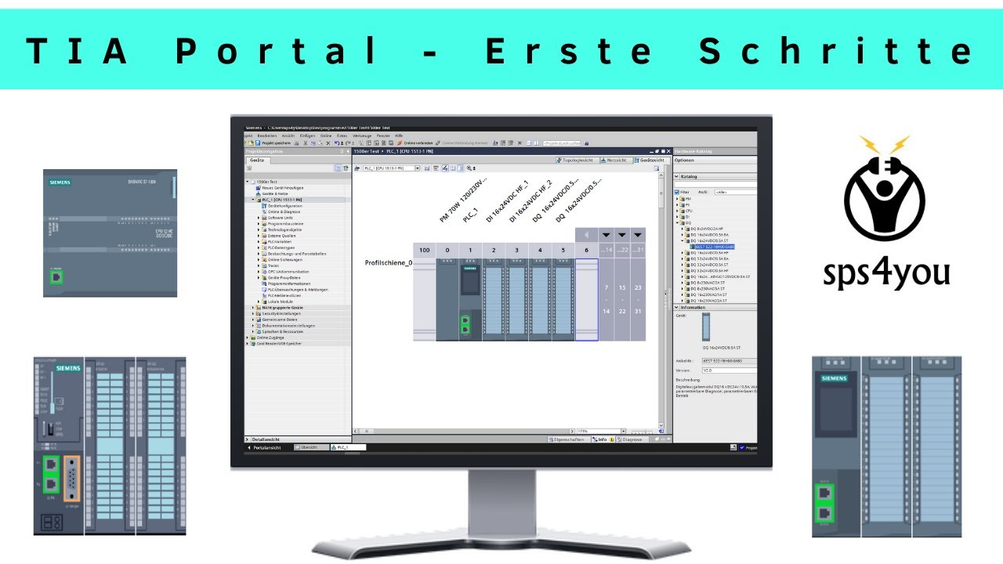
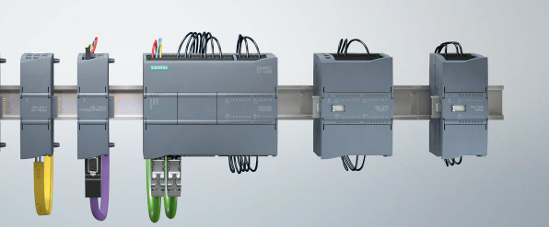
1.2 STRUCTURE A PLC
EXPANDING CPU IN/OUT PORTS
INS3150 - PROGRAMMING PLC

Slide 41
1.2 STRUCTURE A PLC
PROGRAM IMPLEMENTATION
The PLC performs the program in a repeating cycle. Each loop is called a scan loop.
4/ Transfer data from the virtual cache to the offsite
1/ Entering the periphery into the virtual cache
3/ Communication and error self-testing
2/ Implementation of the program
PLC scan cycle
INS3150 - PROGRAMMING PLC

Slide 42
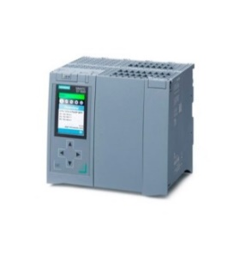
1.2 STRUCTURE A PLC
PROGRAM IMPLEMENTATION
SEND SIGNAL TO OUTPUT
RECEIVING SIGNALS FROM INPUTS
PROGRAM IMPLEMENTATION
MEDIA HANDLING
CPU STATUS CHECK
Each scan round is started with:
The stage reads data from the ports into the virtual buffer.
Program implementation stage.
Internal communication and debugging phase.
The scan round ends with the phase of transferring the contents of the virtual buffer to the output ports.
PLC Scan Cycle
INS3150 - PROGRAMMING PLC

Slide 43

1.2 STRUCTURE A PLC
PROGRAM IMPLEMENTATION
SEND SIGNAL TO OUTPUT
RECEIVING SIGNALS FROM INPUTS
PROGRAM IMPLEMENTATION
MEDIA HANDLING
CPU STATUS CHECK
In each scan, the program is executed with the first command and ends at the end command.
When encountering an entry/exit order, the system will immediately stop all other work, even the interrupt processing program, to execute the command directly with the entry/exit port.
PLC Scan Cycle
INS3150 - PROGRAMMING PLC

Slide 44
1.2 STRUCTURE A PLC
S7-1200 PROGRAM STRUCTURE
Main Program
END
(Perform in one scan)
…
Perform when called by the main program
Perform when there is an interrupt signal
SBR 0 (Subprograms1)
RET
INT 0 (Interrupt Program1)
RETI
…
…
SBR n
(Subprogramsn+1)
RET
INT n
(Interrupt Programn+1)
RETI
…
…
INS3150 - PROGRAMMING PLC

Slide 45
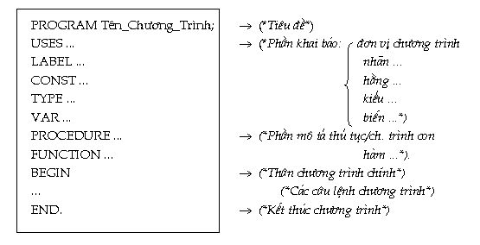
1.2 STRUCTURE A PLC
PROGRAM STRUCTURE
The main program is locked with the END command.
The subprogram is a part of the program. Finish with the RET command and write after the main program.
The interrupt processing program is a part of the program. Finish with the RETI command and write after the main program.
INS3150 - PROGRAMMING PLC

Slide 46
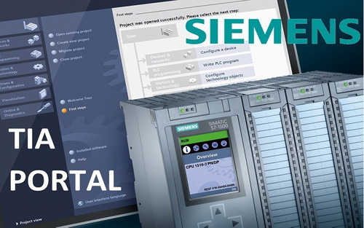
1.2 STRUCTURE A PLC
PROGRAM STRUCTURE
The subprograms are grouped into a group after the main program. Then immediately come to the interrupt processing programs.
It is possible to freely confuse subprograms and interrupt processing programs behind the main program.
The software used for the PLC S7-1200 is TIA PORTAL.
INS3150 - PROGRAMMING PLC

Slide 47


